Slide 1
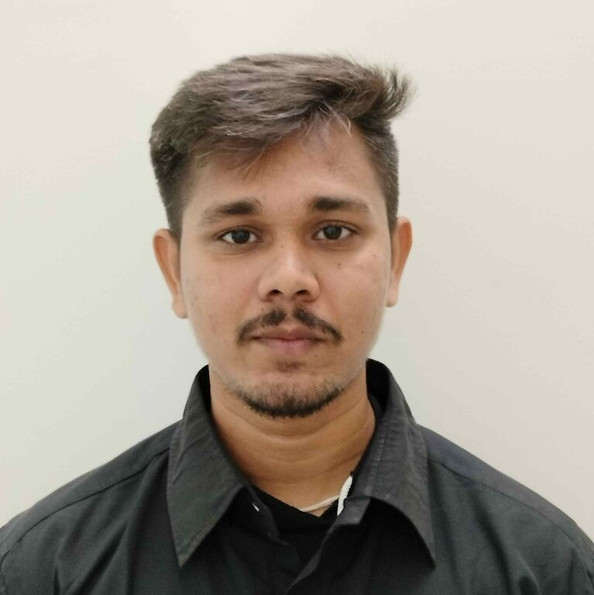



NAGUR SHARIF SHAIK
SYSTEMS ENGINEER
Hyderabad, INDIA
+91-9052596411
Nagursharif.shaik@infosys.com
I have about 1.5 years of experience working as a System Engineer.
My strengths are consistency, dedication, learning new skills, and creativity.
I am a good and quick learner, a team player, and a person who likes to gain knowledge and learn new things from others.
Proficient in problem-solving and task-handling capabilities.
I can work solo and in team. I am good at Time management.
I have completed the INFOSYS Foundation Program with Generic training in JAVA and SQL for DBMS.
Stream specialization training in Automation testing using Selenium along with hands-on experience in it.
Profile
Experience
Capstone Project:
Essence bank application
Tested web application using selenium TestNG and Cucumber, where customer can log in to the application using correct id and password using parameterizations and fetching balance and taking other bank facilities and successfully log out of the application
Pieces Of Training
Generic Training:
Duration:2 Months
Topics Covered: Overview of JAVA, DBMS (SQL).
Stream Specific Training:
Duration:2 Months
Topics Covered: In-Stream Training learned Testing basics and test management, Agile methodology, got hands-on experience in Selenium using Junit and TestNG, and BDD using CUCUMBER.
Technical Skills
/Solution Experience
Language: Java, Python
Database: SQL
IDE: Eclipse, VS Code
Frameworks: Selenium (Junit and TestNG), Cucumber, Specflow, behave.
Certifications
Completed SDET using JAVA and Python.
Other Internal certifications:
Infosys Certified Data Science using Python Professional-Part2
Infosys Certified Data Science using Python Professional-Part1
Education
Masters in Technology (Renewable Energy): Institute of Science and Technology, JNTUK, Kakinada. (2019-22)
Bachelor of Technology (Mechanical Engineering): Bapatla Engineering College, Bapatla. (2013-2017).
Attended for International conference on Reverse engineering and Developed an application using Python programming language.
Other Trainings Attended:
Basics of Python,
Data Science using Python,
Basics of C#.
Basics of API Testing Using Postman
Basics of DevOps
Agile Methodology

